Slide 1
Gabriola Fire Protection Improvement District Election 2026
Presentation by Dr. Matt Dow

Slide 2
Agenda
Introduction
Disclaimer
Gabriola Fire Protection Improvement District
Conclusion
Public Input

Slide 3
Disclaimer:
I will not engage or answer any statements or questions regarding my lawsuit, WorkSafe BC Prohibitive Action Complaint, or Settlement.

Slide 4
"Peace, order and good government"
Source: The foundational motto and legal principle outlined in Section 91 of the British North America Act, 1867 (now. the Constitution Act, 1867).

Slide 5
Gabriola Fire Protection Improvement District
It is extremely rare and a luxury to have full control over Fire Protection Services. The Improvement District belongs to you the ratepayer.
But with “great power [should always] come great responsibility.”

Slide 6
Why YOU & This Election Matter
“…There is no authority for the Inspector to investigate improvement districts. The province recognizes that improvement districts are elected service bodies and have legal authority and responsibility to make decisions on behalf of the property owners they serve. As such, the province does not have a role in reviewing or reversing decisions made or actions taken by a duly elected board of trustees, including administrative and financial decisions...”
--- Tara Faganello, Inspector of Municipalities

Slide 7
Key Areas of Improvement
Inclusion
Transparency
Good Governance
Fiscal Responsibility

Slide 8
Exclusion
Historically, at the heart of Improvement Districts is exclusion. As strictly titleholders of the land on Gabriola can vote.
This has and still does disempower/exclude women, minority groups, young adults, and renters to engage in our Fire Protection Services.

Slide 9
I believe this can be changed.
Election of improvement district trustees
684 (1)In order to vote at an election for improvement district trustees, a person must be
(a)a Canadian citizen,
(b)18 years of age or older, and
(c)entitled to be registered as a voter under the Election Act.
Source: Local Government Act https://www.bclaws.gov.bc.ca/civix/document/id/complete/statreg/r15001_17

Slide 10
The Gabriola Exclusion
There is a tendency by particular interest groups to say that ratepayers who ask question, challenge trustee decisions, and want to be properly informed…are evil or apart of some type of a “cabal.”
This type of mentality or language in my field of study is called conspiratorial discourse, often associated with populist and nationalist movements. This is incredibly dangerous practice that undermines democracy.
In actual reality, this is an extremely healthy democratic practice.

Slide 11
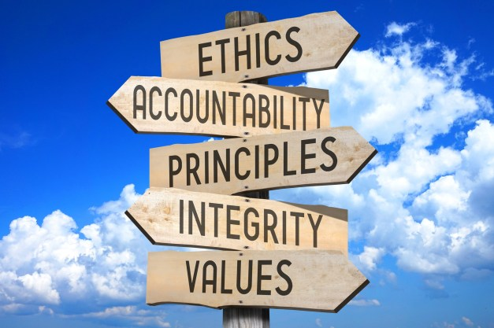
Lack of Transparency

Slide 12
It’s easier & cheaper to be transparent…
In 2024, Professional Fees were: $48,416.
How much was that just from FOIs?
How much have the Trustees spent in 2025 on FOIs?
How much will FOIs cost in 2026?
What are people asking for?

Slide 13
Best practices are already laid out by the following organizations:
Freedom of Information and Protection of Privacy Act
Ombudsperson of BC
Office of the Information & Privacy Commissioner for BC
Who also offer absolutely free advice.

Slide 14
Fiscal Responsibility
Must have:
Strong, Clear & Concise Policies
Comprehensive & Detailed Reports
Public Feedback & Involvement
Proper Reporting Structures

Slide 15
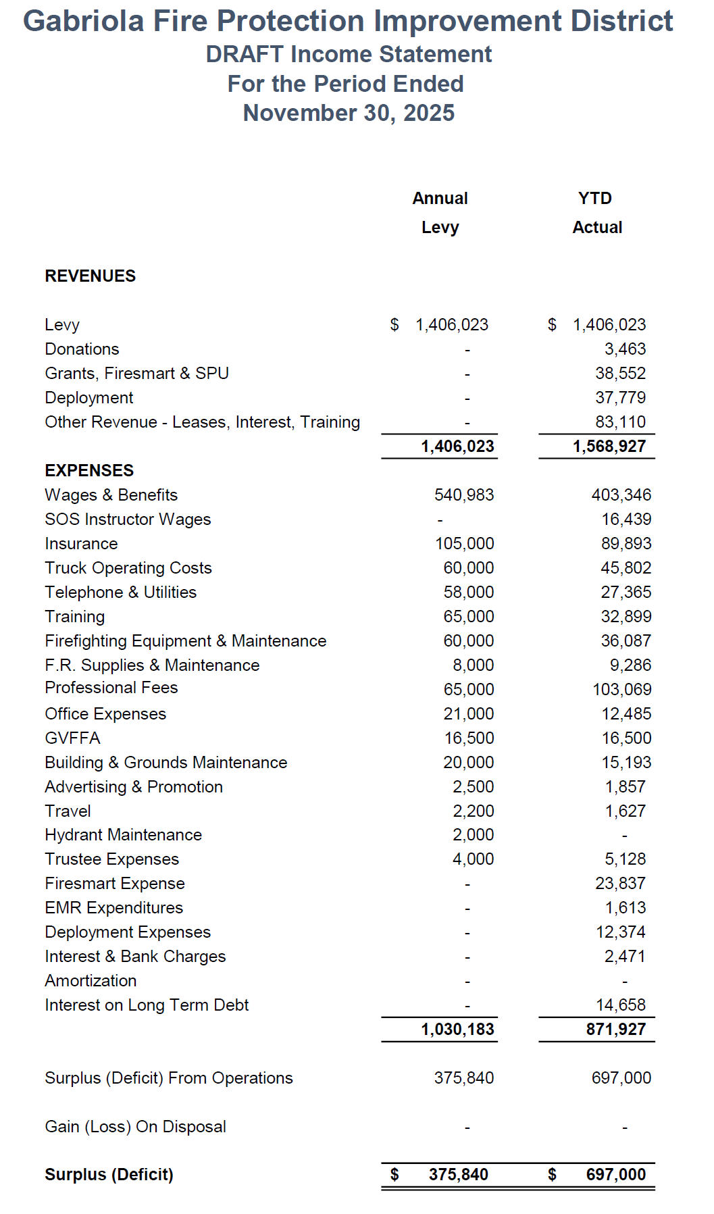

Slide 16
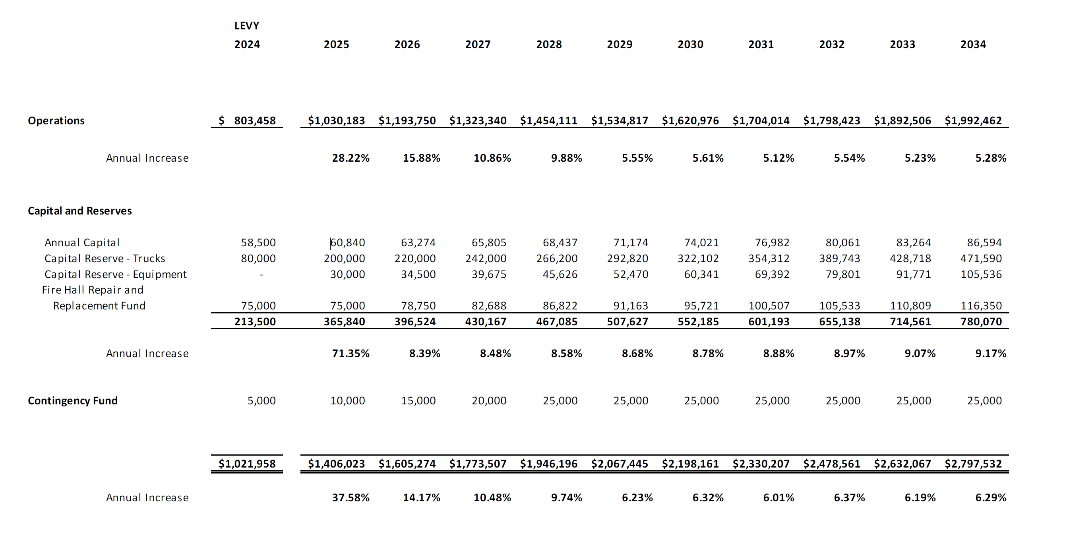

Slide 17
Trustee Mercier states:
It is not customary for trustees to access past in-camera meeting minutes.
It is not customary for trustees to access contracts, correspondence, or employment agreements.
It is not customary for trustees to receive information about payroll or taxes/CRA.
The GFPID does not appear to have maintained accessible hard-copy records of its actions and decisions from past years.
The only financial information customarily reported to trustees is the cash flow statement presented at some General Meetings.
Source: https://gfpidiculous.wordpress.com/

Slide 18
If elected…
I promise to give Gabriolan ratepayers better transparency and governance. By modernizing meetings and bylaws, providing all necessary financial, contract, and other important information so they are always well informed.
I promise to repair the relationship between the Volunteer Firefighters, ratepayers, and wider community of Gabriola. As everyone deserves respect, honesty, a compassionate ear, and voice.
There is no actual PLAN in the Long-Range Plan. So, let’s now make one together.

Slide 19
Thank You For Your Time!

